Slide 1

Marketing Web Analytics and Insights
Group - 9
Group Members:
Bhargava Venkat Lukka
Dharani Chowdary Gundla
Ragini Tiwari
Surya Naga Vinay Bhushan Vinjamuri
Swathi Poluboyana
Venkata Bhavana Praveen Pothuri

Slide 2
All About Target
Fast Facts:
​Target Corporation was established in 1902 as Dayton Dry Goods Company and later renamed in 2000.
It is a general merchandise retailer with over 1,900 stores nationwide and more than 350,000 employees.
75% of the U.S. population lives within 10 miles of a Target store.
Their tagline is "Expect More. Pay Less."
Target Corporation's revenue for the fiscal year 2021 was $106 billion, with a net income of around $4.8 billion.
Major Competitors: Walmart, Amazon, Costco

Slide 3
Business Objectives
Enhancing Customer Experience
Boosting Sales through E-commerce Channel
Improving Customer satisfaction

Slide 4
Boosting E-Commerce Sales
Revenue Vs Transactions
Revenue by Product Category
Marketing Channel

Slide 5
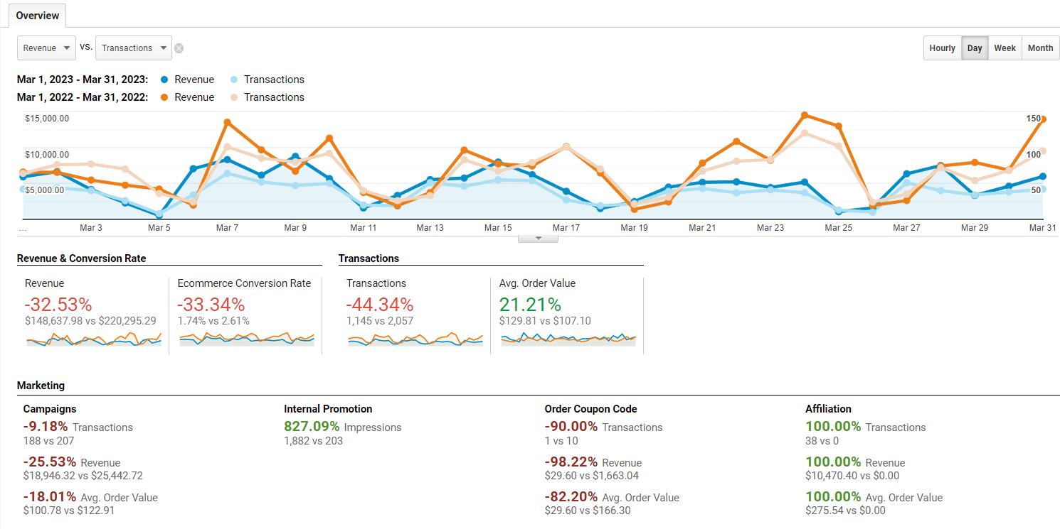
Revenue vs Transactions
Based on this information, we can infer that although the revenue growth, economic conversion rate, and transactions over the year have decreased, the average order value has increased by over 21.21%.
This could indicate that while the website is receiving fewer transactions, the customers who are still making purchases are spending more money per transaction. The increase in average order value could be due to a variety of factors, such as offering higher-priced products or upselling customers to buy more items.

Slide 6
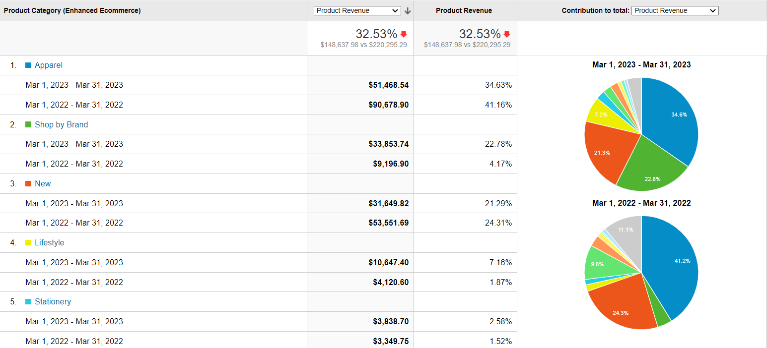
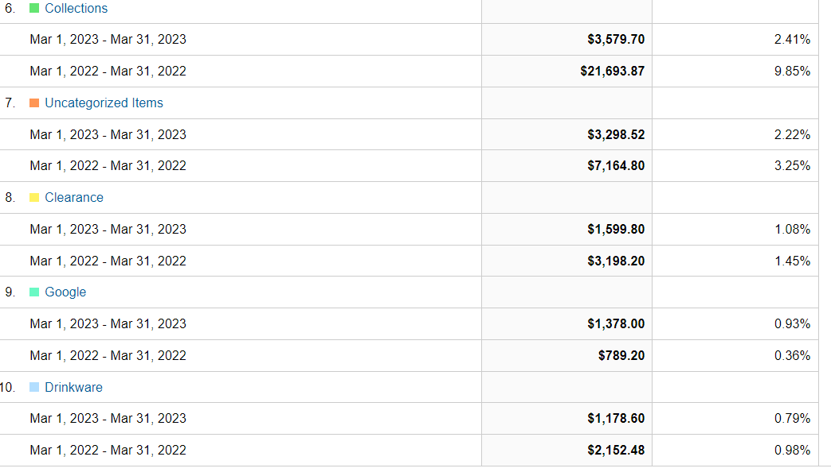
Revenue by Product Category

Slide 7
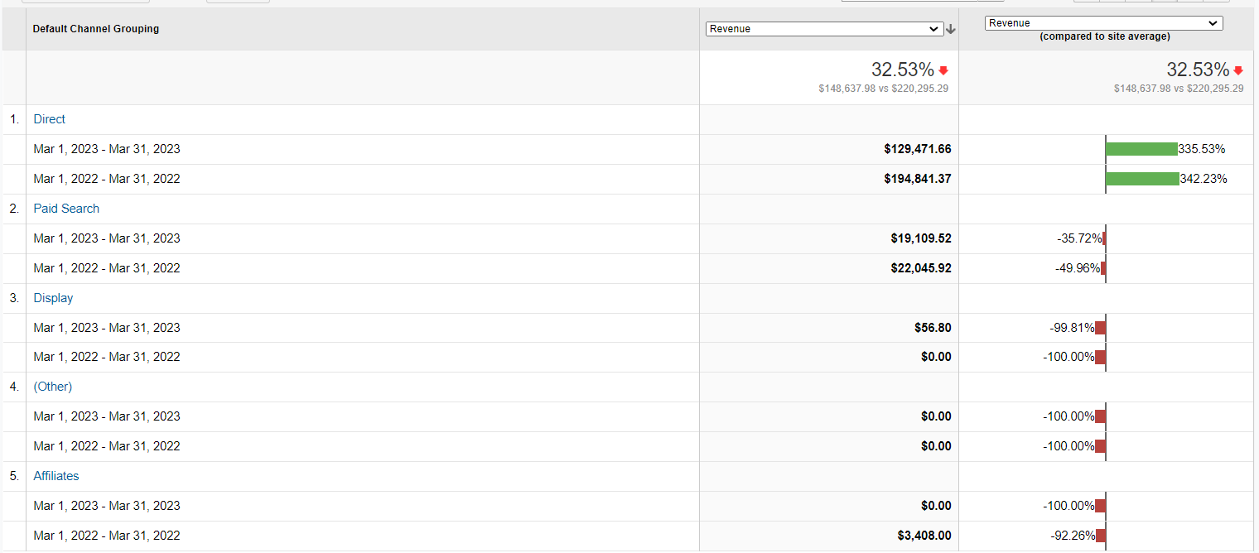
Marketing Channel

Slide 8
Recommendations to Boost Ecommerce Sales
Analyze the competition to identify ways to differentiate the apparel and collections and improve the marketing strategy
Review the paid search campaigns' performance to find ways to improve bidding strategies, such as adjusting keyword bids, to increase the return on investment (ROI) of the paid seoptimizing ad copy arch advertising..
Review the pricing strategy and adjust prices as needed to reflect the value proposition and align with customer expectations

Slide 9
Enhancing User Experience
Bounce Rate
Site Speed
Cart Abandonment

Slide 10
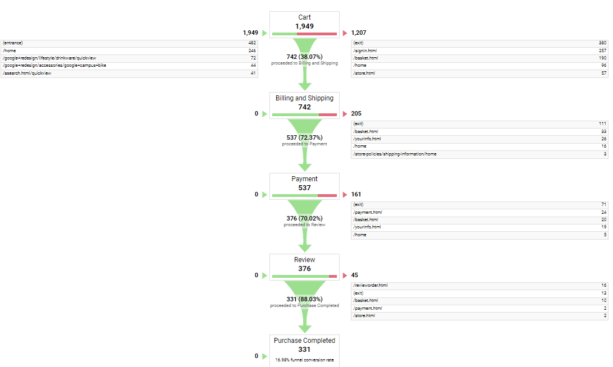
Cart Abandonment

Slide 11
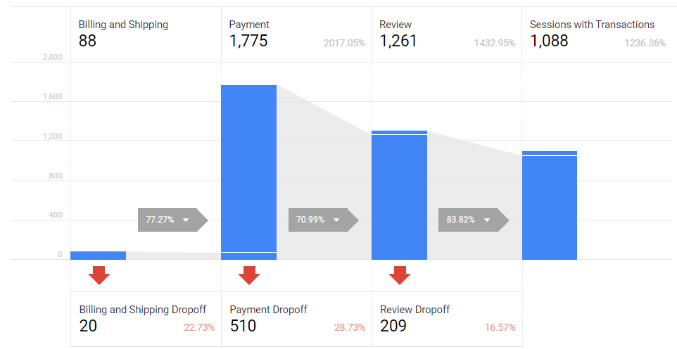
Cart Abandonment
Hidden fees or charges
Lack of payment options
Complicated checkout process

Slide 12
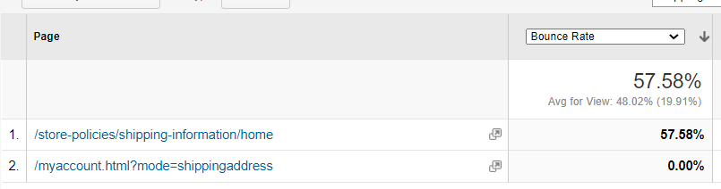
Bounce Rate
The bounce rate of the shipping information page is 57%, indicating that a majority of customers are exiting the website upon reaching this particular page.

Slide 13
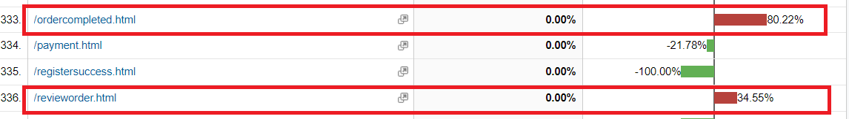
Site Speed
The slower site speed for the order completion page and review order page could have a negative impact on user experience, as customers may become frustrated with longer loading times and potentially abandon their orders.

Slide 14
Recommendations Enhancing Customer Experience
Incentivize customers to complete their orders by offering free additional items.
Encourage customers to purchase more items by offering free next-day delivery above a certain order value, thereby increasing the average order value (AOV).
Provide alternative payment options such as Apple Pay, PayPal, and Google Pay to increase conversions, and consider split-pay options as well.
Improve the design and user experience of the shipping information page: If customers are leaving the site upon reaching the shipping information page, it may indicate that the page is difficult to navigate or unappealing. Consider redesigning the page to make it more user-friendly and visually appealing.
Streamline the checkout process: If the shipping information page is part of the checkout process, consider simplifying the process to make it more efficient and intuitive. A lengthy or confusing checkout process can frustrate customers and lead to higher bounce rates.

Slide 15
Improving Customer satisfaction
Customer Retention
Customer Engagement

Slide 16
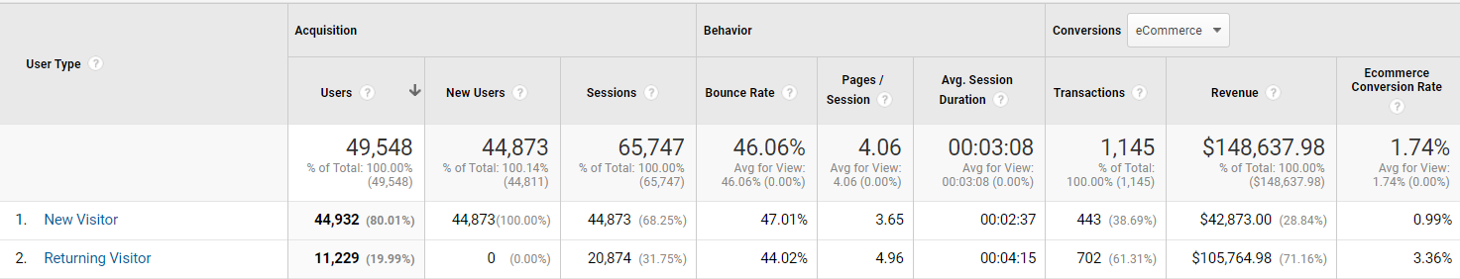
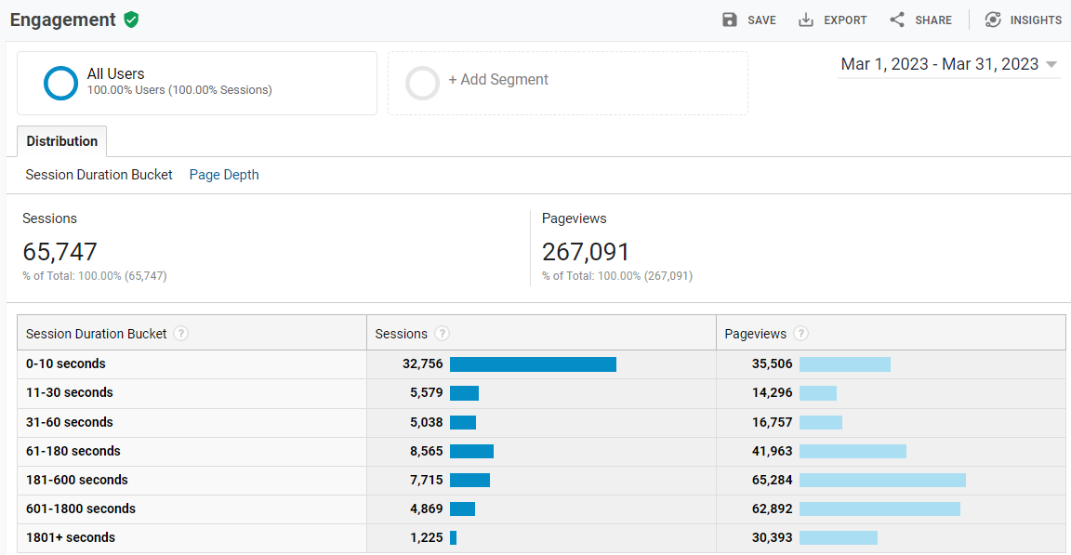
Customer Retention & Engagement
Based on this information, we can infer that a large number of customers are not finding what they are looking for on the website and are leaving quickly (within 10 seconds). However, there is a smaller group of customers who are engaged with the website for a longer time (over 60 seconds) and are driving more page views.

Slide 17
Recommendations To Improve Customer Satisfaction
Keep in touch with returning users via email marketing campaigns. Send regular newsletters, promotional offers, or personalized recommendations based on their previous interactions with your website
Make navigation user-friendly: Ensure that your website is easy to navigate and user-friendly. This will help customers find what they are looking for quickly, and encourage them to explore your website further.
Implement a chatbot: Adding a chatbot to your website can increase engagement time by allowing customers to ask questions and receive immediate answers.
Make sure your website content is fresh, relevant, and adds value for your target audience. Regularly updating your website with new content can keep returning users interested and engaged.

Slide 18

Thank You

